Slide 1
Project 3: Supermarket Sales EDA & SQL
Jarian Del Valle
Dylan Rodriguez
Dara Guadalupe
Natalia Torres

Slide 2
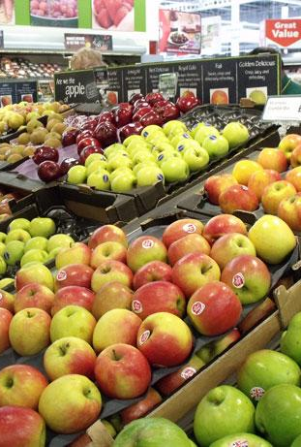
Project Overview
In this project we tackle the evaluation of the supermarket sales dataset, provided by Kaggle. (https://www.kaggle.com/datasets/chadwambles/supermarket-sales?resource=download)
We utilize SQL to query the database and answer 10 business questions pertaining to the dataset.

Slide 3
Project Overview
The dataset concentrates in the product sales and categories of two branches: A and B.
Branch A was focused on New York and Chicago.
Branch B in Los Angeles.

Slide 4
Data Cleaning Process
For the data exploration and cleaning process the Pandas library was utilized to verify and ensure the integrity of the data in the supermarket sales dataset. In the project repository there is a designated .py file where the EDA was conducted.
We found that the supermarket sales dataset does not contain NULL values, making database, table, and query creation easier for data analysis.

Slide 5
Questions

Slide 6
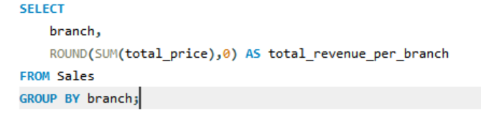

Which branch has the highest total sales revenue?
Query:
Result:

Slide 7
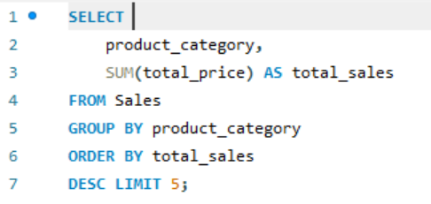

2. What is the most purchased product category across all branches?
Query:
Result:

Slide 8
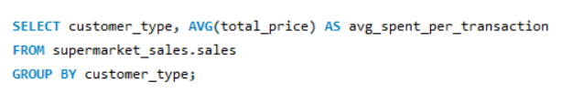

3. Do members or normal customers spend more on average per transaction?
Query:
Result:

Slide 9
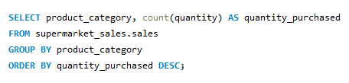
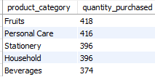
4. How does the quantity purchased vary by product category?
Query:
Result:

Slide 10
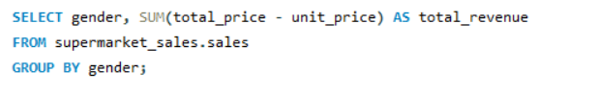

5. Are there differences in total sales revenue between male and female customers?
Query:
Result:

Slide 11
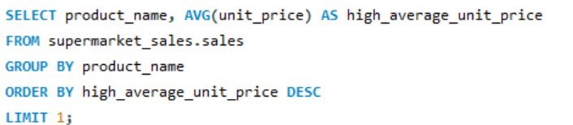

6. Which product has the highest average unit price?
Query:
Result:

Slide 12
7. How do reward points earn correlate with total price spent?
Query:
Result:

Slide 13
7. How do reward points earn correlate with total price spent? Cont.
When evaluating correlation, there seems to be a moderate correlation between the reward points earned and the total price spent on a grocery trip of about 0.6 (rounded).
The scatter plot generated suggests that for every $10 spent on groceries 1 reward point is earned, the bigger the total price that is spent indicates more rewards points are earned. (i.e. $100 -> 10 reward points, $200 -> 20 reward points, etc. )

Slide 14

8. What is the total tax collected per branch?
Query:
Result:

Slide 15
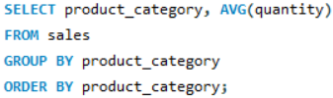
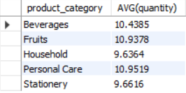
9. What is the average quantity purchased per transaction for each product category?
Query:
Result:

Slide 16
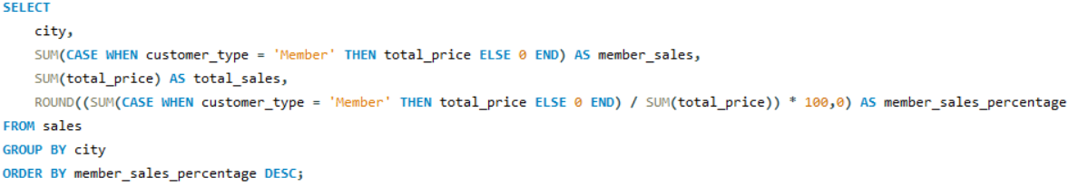

10. Which city has the highest percentage of sales contributed by members?
Query:
Result:

Slide 17
Data Visualizations

Slide 18
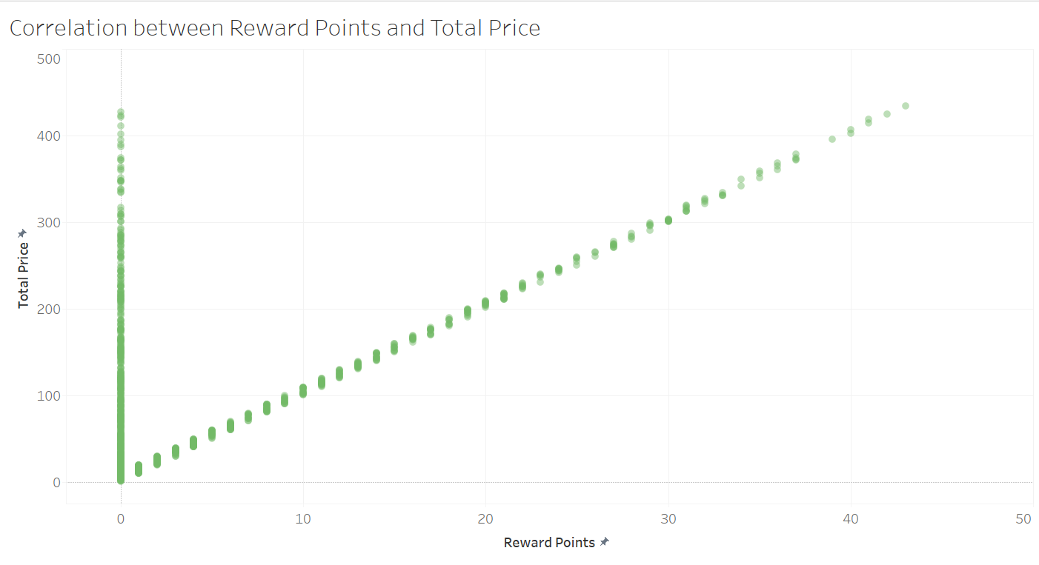

Slide 19
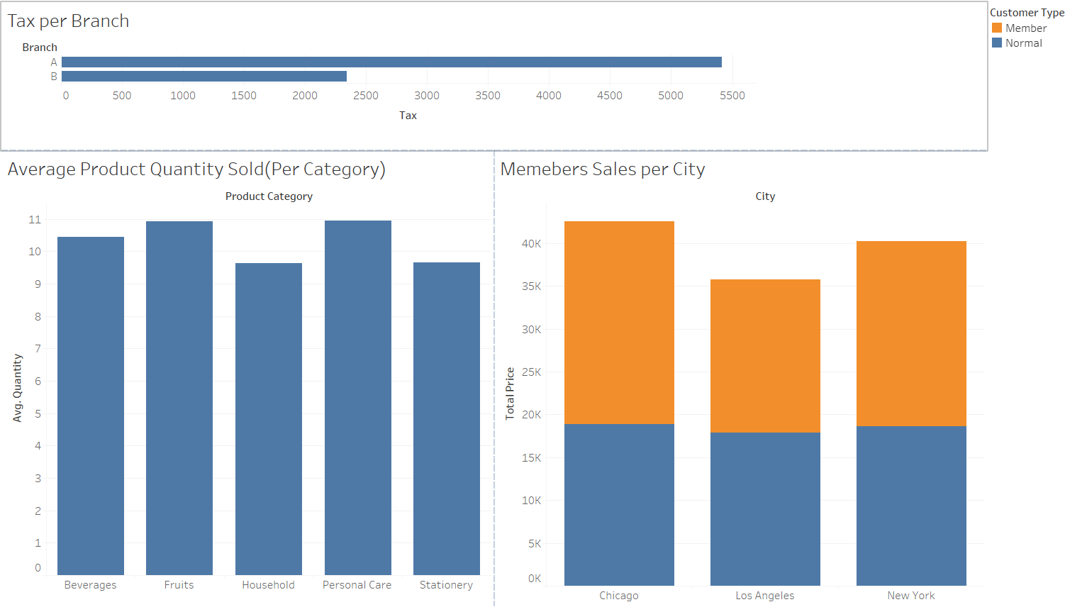

Slide 20
Insights
Branch A had a higher total sale.
Personal care products were the most frequently purchased.
Members spent more on average than normal customers.
Customers have shown a higher average purchase rate for beverages and fruits.
Chicago had more purchases made by members.

Slide 21
Conclusion
Gained valuable insight on how different sales metrics and data are applied to real-world problems.
Made use of the pandas library to do Exploratory Data Analysis on the dataset.
We identified key trends and patterns in the data.
SQL allowed us to efficiently aggregate and filter the data.
EDA helped us uncover insights such as the most popular product categories and purchasing behaviors.

Slide 22
Thank you!
Supermarket Sales EDA & SQL
Jarian Del Valle
Dylan Rodriguez
Dara Guadalupe
Natalia Torres

